Slide 1

Professional Communication in the
U.S. Business Context

Slide 2
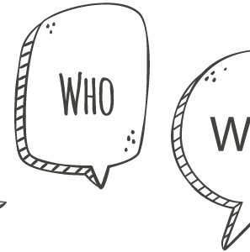
The 3 W’s
Why are we doing this?
Who is going to benefit?
What are the actual benefits?

Slide 3
Actual Benefits
Harvard review report- at many companies, more than three-quarters of an employee’s day is spent communicating with colleagues.
MIT article- oral and written communication skills are among the top five most sought-after attributes in potential new hires.
In most of the job postings, more than 95% of employers find communication skills essential.
MIT Professor Patrick Winston (research areas on Human Intelligence and Machine Learning) – 3 pieces of advice for success in life:
the ability to speak, write, and the quality of our ideas.

Slide 4
Normal Communication
Vs
Business Communication

Slide 5
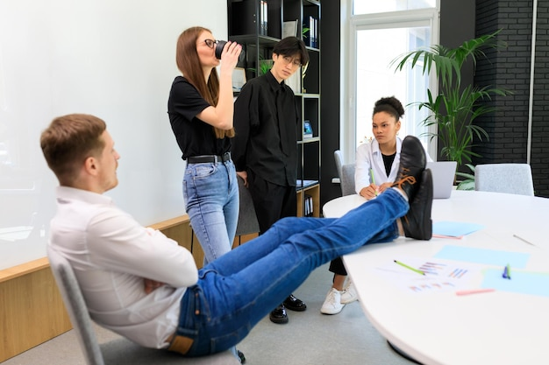

Normal Communication
Normal communication involves informal language and a personal tone and focuses more on building relationships.
It can have slang terms, casual talk, and informal body language.

Slide 6

Business Communication
Maintain professionalism: Avoid discussing personal, emotional, or sexual topics.
Speak professionally: Use appropriate language and tone.
Use professional body language: Maintain good posture and gestures.

Slide 7
Methods of Professional Communication
Needs a more formal approach to achieve business goals and objectives.
Formality helps ensure clarity, professionalism, and respect for the business environment and its stakeholders.
Verbal: Face-to-face meetings, phone calls, video conferencing
Nonverbal: Body language, facial expressions, eye contact
Written: Emails, letters, reports
Professional communication is after all a way of communication.
Generalized Equation: Normal communication + Formality = Professional communication

Slide 8

Cultural differences
Hierarchy and Respect:
U.S.: Less emphasis on hierarchy; open conversations with higher management are encouraged.
Other cultures: More emphasis on hierarchy and respect for authority.
Timeliness and Punctuality:
U.S.: Highly values punctuality as a form of communication that shows care for the job.
Other cultures: Timeliness may be more flexible, with less emphasis on punctuality.

Slide 9

Remote/ Hybrid work culture
Significant Increase in Remote/ Hybrid Work: An integral part of modern business culture due to changing work dynamics.
Need for Netiquette: Ensure appropriate background (real or virtual) during calls to avoid distractions.
Clear and Concise Communication: Importance of providing agendas to prevent misunderstandings and misinterpretations.
Building Relationships: Foster connections through regular check-ins and virtual team-building activities.

Slide 10

Digital Collaboration
Businesses rely on collaboration for success.
Organizations are becoming more globalized.
Remote/ hybrid work culture is on a steady rise.
Software tools have become a new medium for communication and collaboration.
Knowledge of these tools is mandatory to thrive in this changing work dynamics.

Slide 11




Software Tools
Email Management: Outlook, Gmail
Collaboration Tools: Microsoft Teams, Slack
Presentation Software: PowerPoint, Google Slides
Video Conferencing: Zoom, Microsoft Teams

Slide 12
Common Mistakes & Strategies
Thinking they need to adopt a new personality to communicate effectively.
Just be in your personality and present in your unique way as affirmed by Google.
Imitating foreign English accents due to fear of acceptance.
Remember, all that is needed is to convey our idea.
Using slang words such as “what’s”, "wanna," "gonna," etc.
Making grammar, punctuation, and spelling mistakes in writing, particularly among non-native English speakers.
Be mindful and use Grammarly or other resources to check for language mistakes.

Slide 13
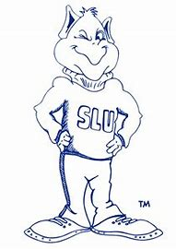
Campus Resources
Career Services
https://www.slu.edu/life-at-slu/career-services/index.php
University Writing Services
https://www.slu.edu/life-at-slu/student-success-center/academic-support/university-writing-services/graduate-writing-resources.php
SLU Library
Big Interview
https://www.slu.edu/life-at-slu/career-services/online-resources.php

Slide 14

SME Suggestion
“Professional” communication builds after we start to “communicate” in the first place.

Slide 15
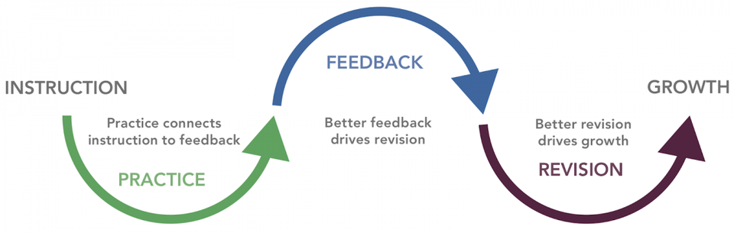
Self-effort is the key
Communication skills cannot be taught; however, they can be developed through proper training, dedication, and hard work.
Practice improves our emotional intelligence which influences how well we communicate.

Slide 16





Practical Suggestions
Enhancing classroom engagement by
encouraging open discussions and group discussions
Exploring Non-Profit internships for hands-on experience
Global Grad Projects & SLU Excelerate Programs
Campus Clubs, Volunteering (on campus and off campus)
https://slu.campuslabs.com/engage/

Slide 17

Effective teamwork begins and ends with communication.

Slide 18

Thank You

